Slide 1
ISTQB Foundation quiz
Studying journey

Slide 2
Chapter1. Fundamentals of Testing

Slide 3
Quiz 1: 1.1 What is Testing?
Quiz 1 | 23 questions
Fundamentals of Testing
1.1 What is Testing?
1.1.1 Typical Objectives of Testing
1.1.2 Testing and Debugging

Slide 4
Question #3 (1 Point) Which of the following statements correctly describes the difference between testing and debugging?
a) Testing identifies the source of defects; debugging analyzes the defects and proposes prevention activities
b) Dynamic testing shows failures caused by defects; debugging eliminates the defects, which are the source of failures
c) Testing removes faults; but debugging removes defects that cause the faults
d) Dynamic testing prevents the causes of failures; debugging removes the failures
Select ONE option

Slide 5
Question #2 (1 Point) Which of the following statements is a valid objective for testing?
a) The test should start as late as possible so that development had enough time to create a good product.
b) To validate whether the test object works as expected by the users and other stakeholders
c) To prove that all possible defects are identified
d) To prove that any remaining defects will not cause any failures
Select ONE option

Slide 6
Question #2 (1 Point) Which of the following is a typical objective of testing?
a) To find defects and failures
b) To validate the project plan works as required
c) Ensuring of complete testing
d) Comparing actual results with expected results
Select ONE option.

Slide 7
Which of the following is a typical test objective?
a) Preventing defects
b) Repairing defects
c) Comparing actual results to expected results
d) Analyzing the cause of failure
Select ONE option

Slide 8
Consider the following statements about testing and debugging and identify which are True:
Debugging is a testing activity
Testers may be invoked in debugging and component testing in Agile development
Testing finds, analyzes and fixes defects
Debugging executes tests to show failures caused by defects
Checking whether fixes resolved the defects found is a form of testing
II and V
II, III and IV
I, II and V
Only V is true

Slide 9
System test execution on a project is planned for eight weeks. After a week of testing, a tester suggests that the test objective stated in the test plan of “finding as many defects as possible during system test” may be more closely met by redirecting the test effort in what way?
By asking a selection of users what is most important for them, and testing that.
By testing the main workflows of the business.
By repeating the unit and integration tests.
*By testing in areas where the most defects have already been found.

Slide 10
Consider the following definitions and match the term with the definition
The reason or purpose of testing.
The work product to be tested
Confirmation by examination and through provision of objective evidence that the requirements for a specific intended use or application have been fulfilled.
I. test object, II. test objective, III. validation
* I. test objective, II. test object, III. validation
I. validation, II. test basis, III. verification

Slide 11
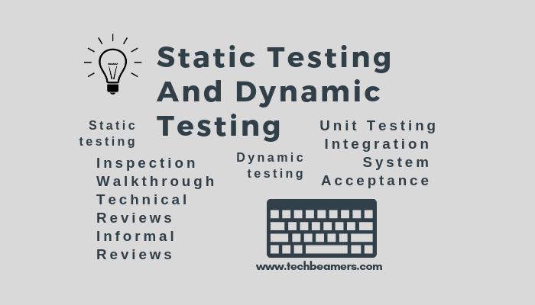
3.1 Static Testing Basics
Quiz 01 | 19 questions
3.1 Static Testing Basics
3.1.1 Work products that can be examined by static testing
3.1.2 Benefits of static testing
3.1.3 Differences between static and dynamic testing.

Slide 12
Q1: which testing technique would be most effective in determining and improving the maintainability of the code ( assuming developers fix what is found)?
Peer reviews
Static analysis
Dynamic testing
Unit testing
Notes:
Static analysis with tools will give the best results for improving maintainability and ensuring adherence to good coding practices.

Slide 13
Q2: Which of the following techniques is a form of static testing?
Error guessing
Automated regression testing
Providing inputs and examining the resulting outputs
Code preview.

Slide 14
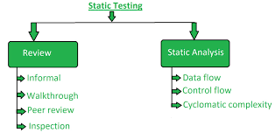
Q3. Which of the following is a benefit of static analysis?
Defects can be identified that might not be caught by dynamic testing.
Early defect identification requires less documentation.
Early execution of the code provides a gauge of code quality.
Tools are not needed because reviews are used instead of executing code.
Notes:
Static analyzer can be used to find defects such as uninitialized variables that could be difficult to catch with dynamic testing.

Slide 15
Q4: What is the main difference between static and dynamic testing?
Static testing is performed by developers; dynamic testing is performed by testers.
Manual test cases are used for dynamic testing; automated tests are used for static testing.
Static testing must be be executed before dynamic testing.
Dynamic testing requires executing the software; the software is not executed during static testing.

Slide 16
Q5: which of the following statements about static testing is False?
Reviews are applicable to web pages and user guides.
Static analysis is applicable to executing test scripts.
Static analysis can be applied to work products written in natural language (e.g. English).
Reviews can be applied to security requirements and project budgets.

Slide 17
Q6: which of the following statements are characteristics of static testing, and which are characteristics of dynamic testing?
Find defects in work products directly.
Better for ensuring internal quality (e.g. standards are followed).
Find defects through failures in execution.
Easier and cheaper to find and fix security vulnerabilities (e.g. buffer overflow).
Focus on external visible behaviors.
Static testing: 2 and 4; Dynamic testing: 1, 3, and 5.
Static testing: 3 and 5; Dynamic testing: 1, 2, and 4.
Static testing: 1, 2 and 4; Dynamic testing: 3, and 5.
Static testing: 1, 2 and 3; Dynamic testing: 4 and 5.

Slide 18
Q7: which of the following statements BEST states the values of static testing?
It can prevent defects later in the design and coding by uncovering issues in requirements.
It’s most effective when performed after dynamic testing.
It can detect the same defects as those found by dynamic testing.
It can eliminate the need for unnecessary team member communication.

Slide 19
Q8: typical defects discovered by static analysis includes:
Programming standard violations
Variables with undefined values
Unreachable code and duplicate code
All of above.

Slide 20
Q9: Which statement about the function of a static analysis tool is true?
Gives quality information about the code without executing it *.
Check expected results against actual results
Can detect memory leaks
Give information about what code has and has not been exercised.

Slide 21
Q10: In which phase static tests are used?
Requirements
Design
Coding
All of above.

Slide 22
Q11: Which of the following software work products would be examined using static testing (reviews and/or static analysis) techniques?
Test procedure
Component’s code
Web pages
Test cases
User stories.
1, 2, 3, and 4
1, 2, 3, 4 and 5
2, 3, 4, and 5
1, 2, and 4

Slide 23
Q12: which of the following artifacts can be examined by using review techniques?
Software code
Requirements specification
Test plans
All of the above.

Slide 24
Q13: defects discovered by static analysis tools included:
Variables that are never used
Security vulnerabilities
Programming standard violations
Uncalled functions and procedures.
A 1, 2, and 3
B. 2, 3, and 4
C. 1,3, and 4
D all of above.

Slide 25
Q14: Why are static testing and dynamic testing described as complementary?
Because they share the aim of identifying defects and find the same types of defect.
Because they have different aims and differ in the types of defect they find.
Because they have different aims but find the same type of defect.
Because they share the aim of identifying defects but differ in the types of defect they find.

Slide 26
Q15: which of the following types of defects are typically found in reviews rather than in dynamic testing?
Deviations from standards
Poor performance of the system.
Poor maintainability of code
Defects in requirements.
1 and 4
1 and 3
1, 2, and 4
1, 3, and 4

Slide 27
Q16: what statement about static analysis is true?
With static analysis, defects can be found that are difficult to find with dynamic testing.
Compiling is not a form of static analysis.
When properly performed, static analysis makes functional testing redundant.
Static analysis finds all faults.

Slide 28
Q17: which typical defects are easier to find using static instead of dynamic testing?
Deviation from standards.
Requirements defects.
Insufficient maintainability.
Incorrect interface specifications.
1, 3, and 4
1 and 3
1, 2, 3, and 4
1, 2, and 3

Slide 29
Q18: which of the following statements regarding static testing is false
Static testing requires the running of tests through the code*
Prevents defects in future design and code.
Improved communication within the team.
Reducing total cost of quality.

Slide 30
Q19: Which of the following statements about static analysis is FALSE?
Static analysis can find defects that are likely to be missed by dynamic testing.
Static analysis is a good way to force failure in the software.
Static analysis tools examine code or other types of product documentation
Static analysis can result in cost saving by finding bugs early.

Slide 31
3.2 Review Process Quiz
3.2 Review Process
3.2.1 Work product review process
3.2.2 roles and responsibilities in a formal review
3.2.3 review types
3.2.4 applying review techniques
3.2.5 success factors for reviews

